Slide 1
Data Analytics Algorithms
Python is one of the most popular languages for Analytics in 3rd level and industry. One of the main reasons for this is the speed at which you can conduct Analysis such as getting the maximum and minimum values of a list.
We can also use the statistics library to find the mean, median and mode or we can code these without the use of a library.

Slide 2
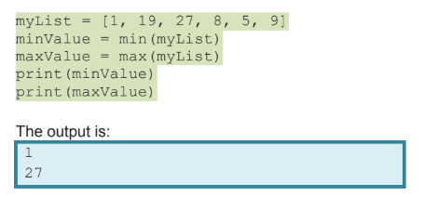
Max and Min Values
Method 1: Using Inbuilt functions

Slide 3
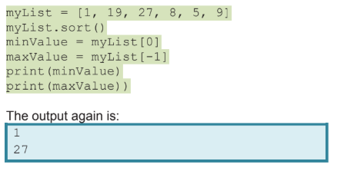
Max and Min Values
Method 2: Using Sorting and extracting the First and Last Value

Slide 4
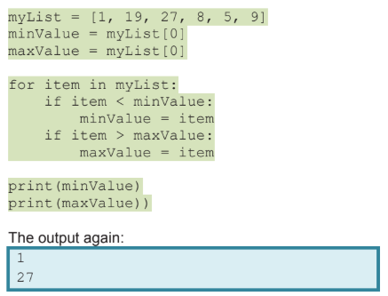
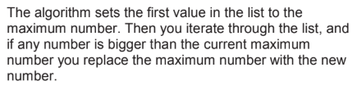
Max and Min Values
Method 3: Manually Coding

Slide 5
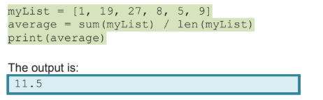
Mean
Method 1: Using sum() and len()

Slide 6
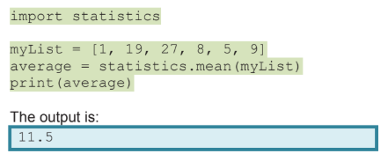
Mean
Method 2: Using statistics library

Slide 7
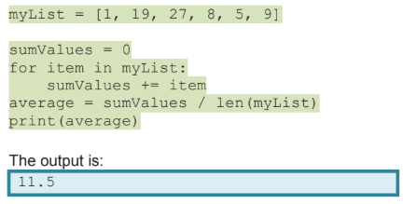
Mean
Method 3: Manually Coding

Slide 8
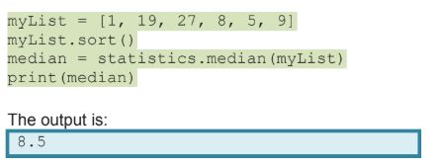
Median
Method 1: Using the statistics library

Slide 9
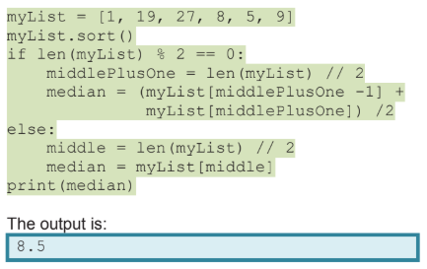
Median
Method 2: Manually Coding
Note: The median is the middle number of a sorted list.
If there is an even number of elements in the list then the median is the middle two numbers added together and divided by 2.

Slide 10
Frequency
Frequency is the number of times elements appear in a list, this can be for strings or numbers.

Slide 11
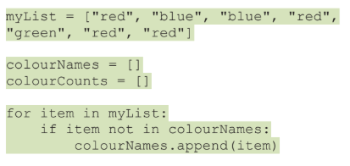
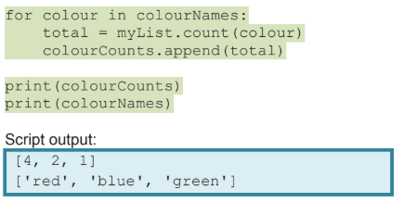
Frequency
Creates two empty lists
Loops through myList. If the item is not already in the colourNames list then add it to the list.
Loops through the colourNames list and counts the amount of times each colour is in myList

Slide 12
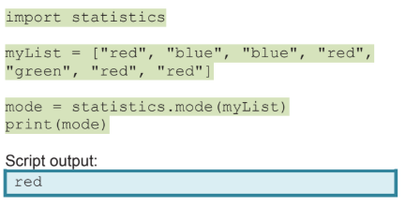
Mode
Mode is the value that occurs most often in the dataset.
Method 1: Using statistics library

Slide 13

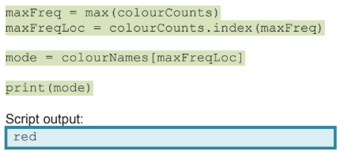
Mode
Method 2: Manually Coding

